Slide 1
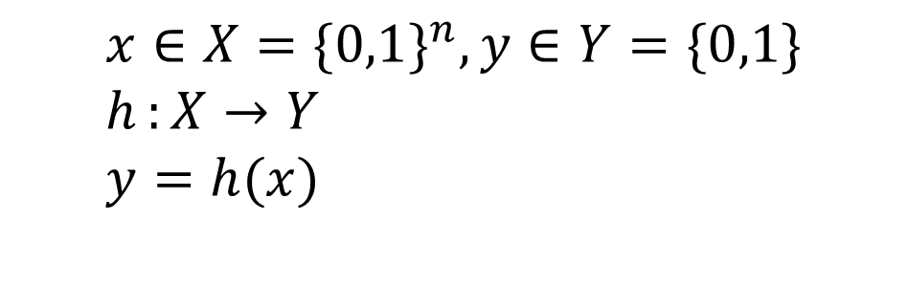
Classification
Classification:
predicts categorical class labels
Typical applications
{credit history, salary}-> credit approval (Yes/No)
{temp, humidity} --> rain (Yes/No)
$$x∈X=\{0,1\}^{n},y∈Y=\{0,1\} \\ h:{X}→Y \\ y=h(x)$$
Mathematically

Slide 2
Linear Classification
Binary classification problem
The data above the red line belongs to class ‘x’
The data below red line belongs to class ‘o’
Examples: SVM, Perceptron, Probabilistic Classifiers
x
x
x
x
x
x
x
x
o
x
o
x
o
o
o
o
o
o
o
o
o
o
o

Slide 3
Timeline of Neural Network History
1950
1960
1970
1980
1990
2000
2010
2020
Transformers
Gradient Descent
Convolutional Nets
Adversarial Attack
Back Propagation
Attention Mechanics
Self-Organized Maps
Support Vector Machine
Graph Neural Network
Contrastive Divergence
Concept of neural networks*
Multiple-layer Propagation
Long-Short-Terms Memories
Restricted Boltzmann Machine
Generative Adversarial Network

Slide 4
Classification by Backpropagation
Backpropagation: A neural network learning algorithm
Started by psychologists and neurobiologists to develop and test computational analogues of neurons
A neural network: A set of connected input/output units where each connection has a weight associated with it
During the learning phase, the network learns by adjusting the weights so as to be able to predict the correct class label of the input tuples
Also referred to as connectionist learning due to the connections between units

Slide 5
A Neuron (a perceptron)
-
θ_{k}
x₁
w₁
x₂
.
.
.
w₂
.
.
.
∑
f
output O
x_{n}
w_{n}
Input
vector x
weight
vector w
weighted
sum
Activation
function
The n-dimensional input vector x is mapped into variable o by means of the scalar product and a nonlinear function mapping

Slide 6
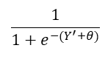
Neuron processing element (McCulloch-Pitts Model)
Y’ = Neuron input =
Neuron output (O)=
$$\frac{1}{1+e^{−(Y^{′}+θ)}}$$
X₁=3
W₁=0.2
X₂ =1
W₂=0.4
Threshold
Θ
Y’=1.2
X₃=2
W₃=0.1
Notes:
Err_{j}=O_{j}(1-O_{j})(O_{j}-T_{j}), w_{ij}=w_{ij}+l Err_{j} X_{i}, τηετα_{j}=theta_{j}+l Err_{j}
E=(O_{j}-T_{j})^2/2, D[E,x]=D(E, O_{j}]*D[O_{j},x]=(O_{j}-T_{j})O_{j}(1-O_{j})

Slide 7
Learning process
Compute output
No
Is
desired output
achieved?
Adjust weights
Yes
Stop

Slide 8
Computational capabilities of McCulloch-Pitts model
OR
x₁
x₁ | x₂ | WX-Θ | T
0 | 0 | -0.5 | 0
0 | 1 | 0.5 | 1
1 | 0 | 0.5 | 1
1 | 1 | 1.5 | 1
1
O
1
Θ=-0.5
x₂
W X+Θ = x₁+x₂-0.5

Slide 9
The limitation of one-layer network
Theorem: There exist logical functions that can’t be realized by a single binary threshold function.
X₂
X₁+X₂−0.5=0
(0,1)
(1,1)
Threshold
being exceeded
Threshold
not exceeded
X₁
(0,0)
(1,0)

Slide 10
Extending to 3D
X₁
W₁ X₁+ W₂ X₂+ W₃ X₃= W₀
X₃
X₂

Slide 11
Example
XOR can’t be realized be a single binary threshold function. (Why?)
X₂
(0,1)
(1,1)
X₁
(0,0)
(1,0)

Slide 12
Non-linearly separable problems
Perceptron algorithm is poorly behaved when patterns are non-linear separable
The task of finding an optimal separable hyperplane is NP-hard
C₁
C₂

Slide 13
Multi-layer (non-linear) networks
Motivations
Overcome the limitations of linear networks for function approximation
Overcome the limitations of perceptrons for pattern recognition
Overcome the limitations of classical behoviorist models of psychology
Non-linear control systems
Statistical regression

Slide 14
Xor (revisited)
Input
units
Hidden
Units
Output
Units
Input |  | Output
x₁ | x₂ | T
0 | 0 | 0
0 | 1 | 1
1 | 0 | 1
1 | 1 | 0
x₁
+1
+1
-1
O
-1
x₂
+1
+1
Thresholds = −0.1

Slide 15
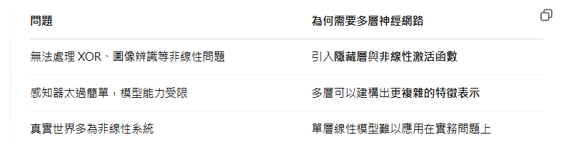

Slide 16
Parameter update
Stochastic Gradient Descent
Every parameter update requires to see 1 of n training instances
Batch
To see each instance of n training instances
Mini batch
To see b of n training instances, where b denotes the batch size

Slide 17
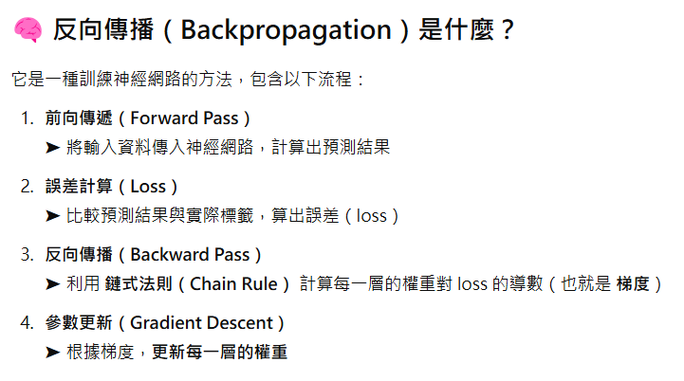

Slide 18
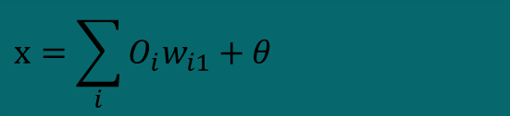
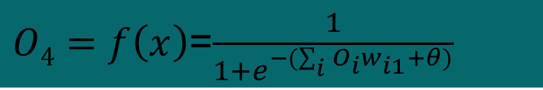
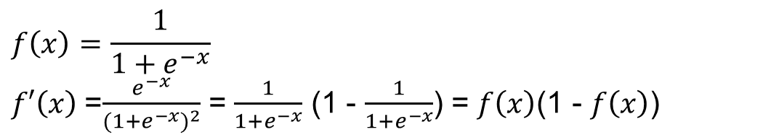
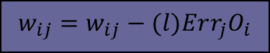
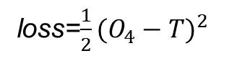

Feed-Forward Neural Network
loss=$\frac{1}{2}{(O_{4}−T)}^{2}$
$$w_{ij}=w_{ij}−(l)Err_{j}O_{i}$$
Output layer
N₄
$${Err}_{j}={O_{j}(1−O_{j})(O_{j}−T)}_{ }$$
w₁₁
w₂₁
w₃₁
$O4=f\left(x\right)$=$\frac{1}{1+e^{−(\sum_{i}{O_{i}w_{i1}+θ})}}$
Input layer
N₁
N₂
N₃
$$x=\sum_{i}{O_{i}w_{i1}+θ}$$
Sigmoid function
$$f\left(x\right)=\frac{1}{1+e^{−x}}$$
$f′\left(x\right)$=$\frac{e^{−x}}{{(1+e^{−x})}^{2}}$ = $\frac{1}{1+e^{−x}}$ (1 - $\frac{1}{1+e^{−x}}$) = $f\left(x\right)$(1 - $f\left(x\right)$)
Notes:
Loss function
L=1/2(O₁-T₁)²

Slide 19

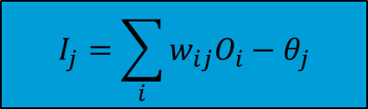
Multi-Layer Feed-Forward Neural Network
Output vector
$$Err_{j}=O_{j}(1−O_{j})(O_{j}−T_{j})$$
j=6-8
Output layer
N₆
N₇
N₈
Hidden layer
N₄
j=3-5
N₃
N₅
w_{ij}
Input layer
N₁
N₂
$$I_{j}=\sum_{i}{w_{ij}O_{i}−θ_{j}}$$

Slide 20
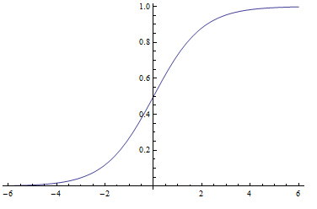
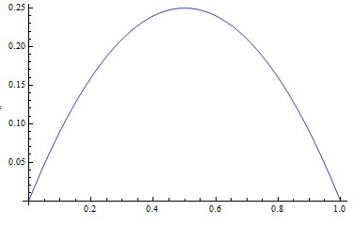
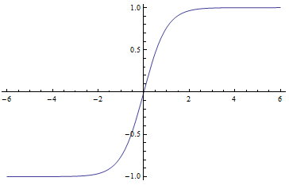
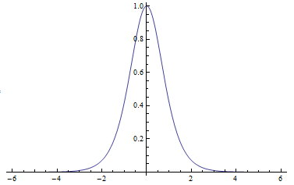
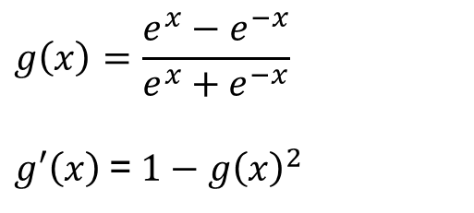
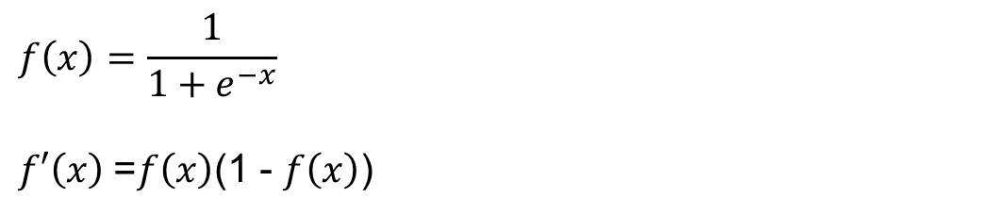
Activation functions
Sigmoid
Hyperbolic tangent
$$f\left(x\right)=\frac{1}{1+e^{−x}}$$
$f′\left(x\right)$=$f\left(x\right)$(1 - $f\left(x\right)$)
$$g\left(x\right)=\frac{e^{x}−e^{−x}}{e^{x}+e^{−x}}$$
$g′\left(x\right)$=${1−g\left(x\right)}^{2}$

Slide 21
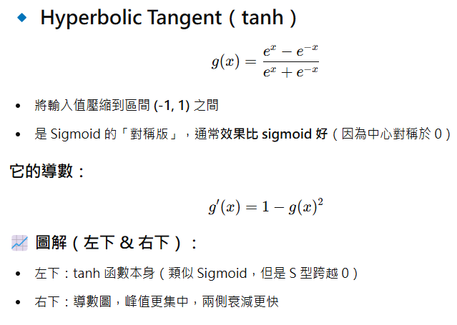
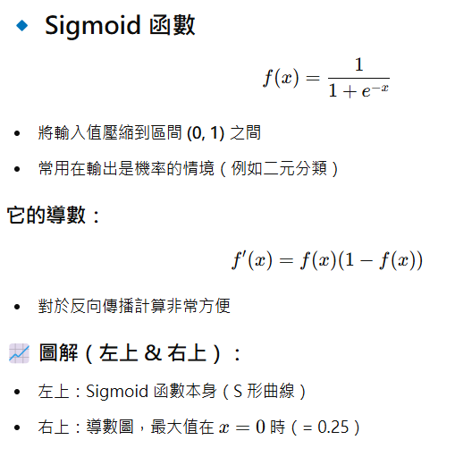
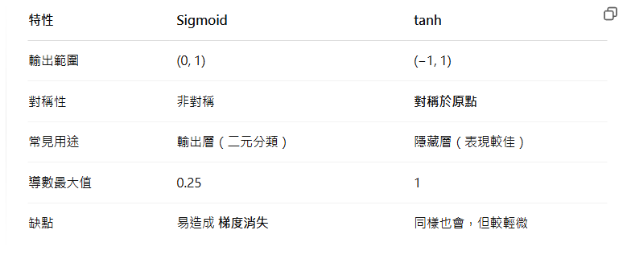

Slide 22
Multi-Layer Feed-Forward Neural Network
Output vector
$$Err_{j}=O_{j}(1−O_{j})(O_{j}−T_{j})$$
j=6-8
Output layer
N₆
N₇
N₈
Hidden layer
N₄
j=3-5
N₃
N₅
w_{ij}
Input layer
N₁
N₂
$$I_{j}=\sum_{i}{w_{ij}O_{i}−θ_{j}}$$

Slide 23
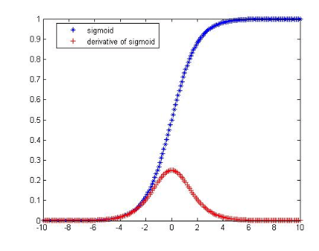
Vanishing gradient problem
The vanishing gradient problem is a difficulty found in training artificial neural networks with gradient-based learning methods and backpropagation. In such methods, each of the neural network's weights receives an update proportional to the gradient of the error function with respect to the current weight in each iteration of training.
Traditional activation functions such as the hyperbolic tangent function have gradients in the range (−1, 1).
By multiplying n of these small numbers to compute gradients of the "front" layers in an n-layer network, the gradient (error signal) decreases exponentially with n while the front layers train very slowly.
The maximum of derivative of sigmoid is 0.25. Hence feedback will vanish when the number of layers is large.

Slide 24
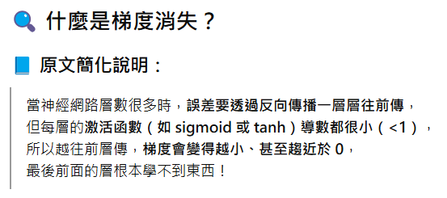
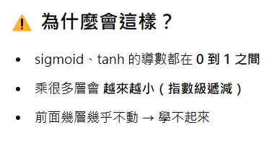
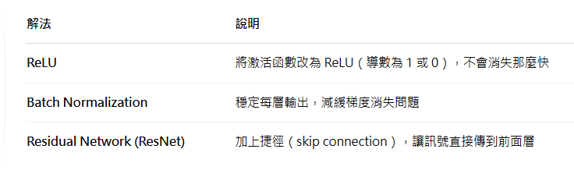

Slide 25
Multi-Layer Neural Network
Inputs are fed simultaneously into the units making up the input layer
They are then weighted and fed simultaneously to a hidden layer
The outputs of each hidden layer are propagated into the next hidden layer
The weighted outputs of the last hidden layer are input to units making up the output layer, which emits the network's prediction
The network is feed-forward in that none of the weights cycles back to an input unit or to an output unit of a previous layer

Slide 26
Behavior of multilayer neural networks
Types of
Decision Regions
Exclusive-OR
Problem
Classes with
Meshed regions
Most General
Region Shapes
Structure
Single-Layer
Half Plane
Bounded By
Hyper plane
A
B
B
A
B
A
Two-Layer
Convex Open
Or
Closed Regions
A
B
B
A
B
A
Three-Layer
Arbitrary
(Complexity
Limited by No.
of Nodes)
A
B
B
A
B
A

Slide 27
CNN & RNN

Slide 28
Convolutional Neural Network (CNN)
Convolutional Neural Networks are neurobiologically motivated by the findings of locally sensitive and orientation-selective nerve cells in the visual cortex
They designed a network structure that implicitly extracts relevant features
CNN’s are a special kind of multi-layer neural networks
Notes:
In 1995, Yann LeCun (Professor of Computer Science, The Courant Institute of Mathematical Sciences, New York University) and Yoshua Bengio introduced the concept of convolutional neural networks

Slide 29
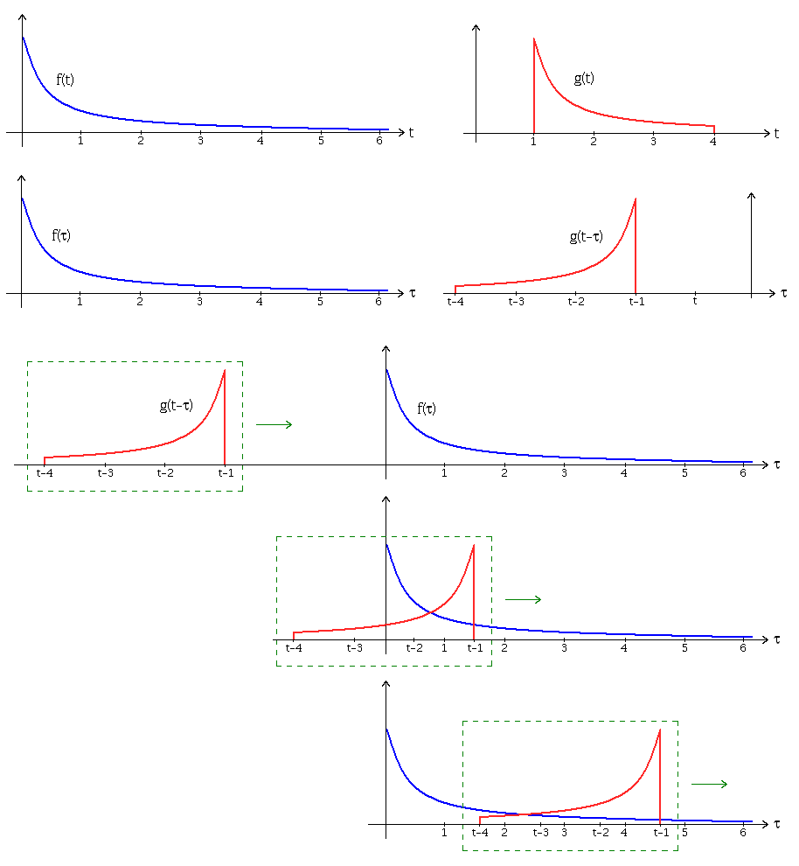
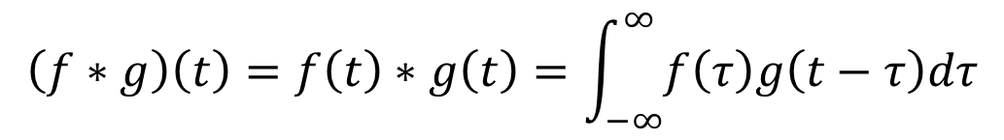
Convolution
$$\left(f∗g\right)\left(t\right)=f\left(t\right)∗g\left(t\right)=\int_{−∞}^{∞}{f\left(τ\right)g\left(t−τ\right)dτ}$$

Slide 30
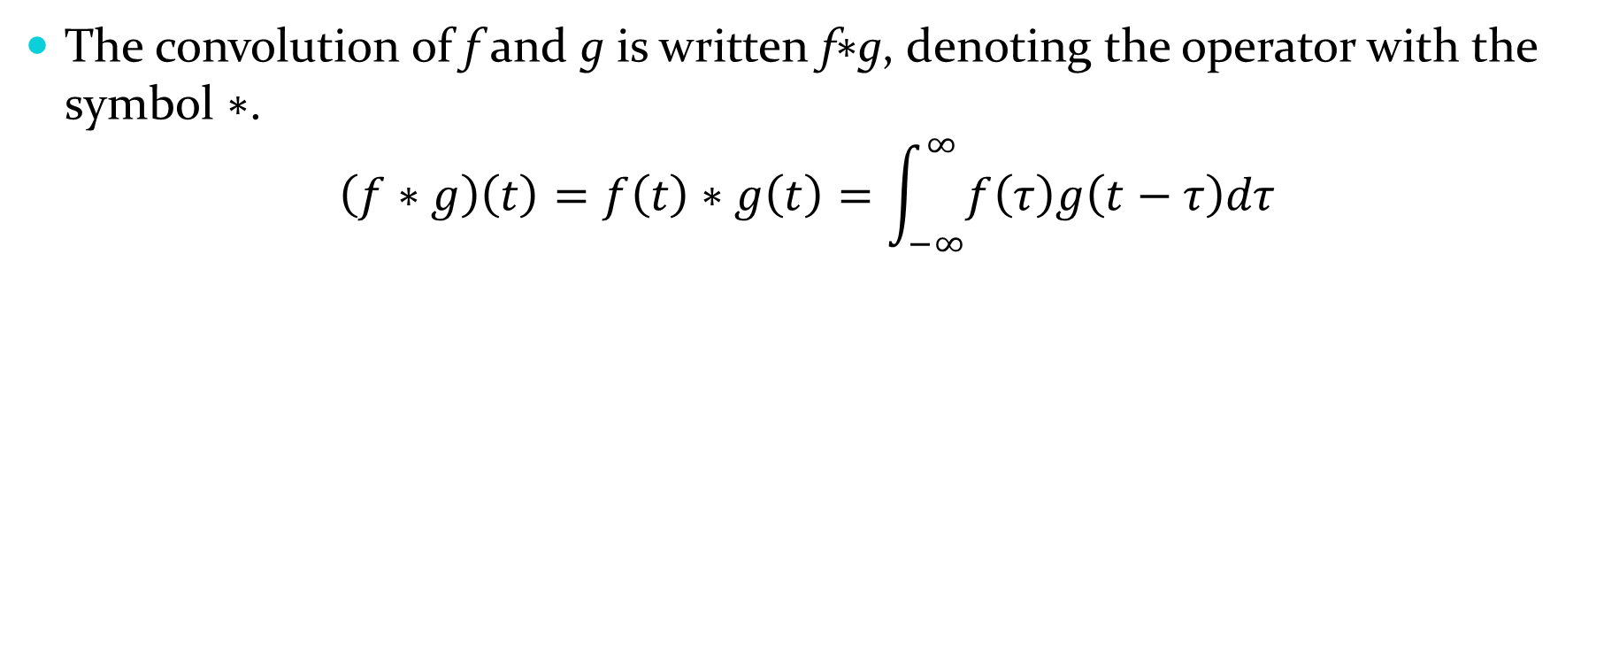
Convolution
The convolution of f and g is written f∗g, denoting the operator with the symbol ∗.
$$\left(f∗g\right)\left(t\right)=f\left(t\right)∗g\left(t\right)=\int_{−∞}^{∞}{f\left(τ\right)g\left(t−τ\right)dτ}$$
10 | 10 | 10 | 0 | 0 | 0
10 | 10 | 10 | 0 | 0 | 0
10 | 10 | 10 | 0 | 0 | 0
10 | 10 | 10 | 0 | 0 | 0
10 | 10 | 10 | 0 | 0 | 0
10 | 10 | 10 | 0 | 0 | 0
0 | 30 | 30 | 0
0 | 30 | 30 | 0
0 | 30 | 30 | 0
0 | 30 | 30 | 0
1 | 0 | -1
1 | 0 | -1
1 | 0 | -1

Slide 31
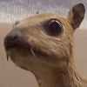

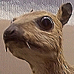
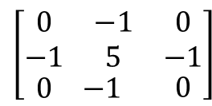
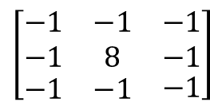
Convolution
$$\left[\begin{matrix}\begin{matrix}−1 & −1 \\ −1 & 8\end{matrix} & \begin{matrix}−1 \\ −1\end{matrix} \\ \begin{matrix}−1 & −1\end{matrix} & −1\end{matrix}\right]$$
$$\left[\begin{matrix}\begin{matrix}0 & −1 \\ −1 & 5\end{matrix} & \begin{matrix}0 \\ −1\end{matrix} \\ \begin{matrix}0 & −1\end{matrix} & 0\end{matrix}\right]$$

Slide 32
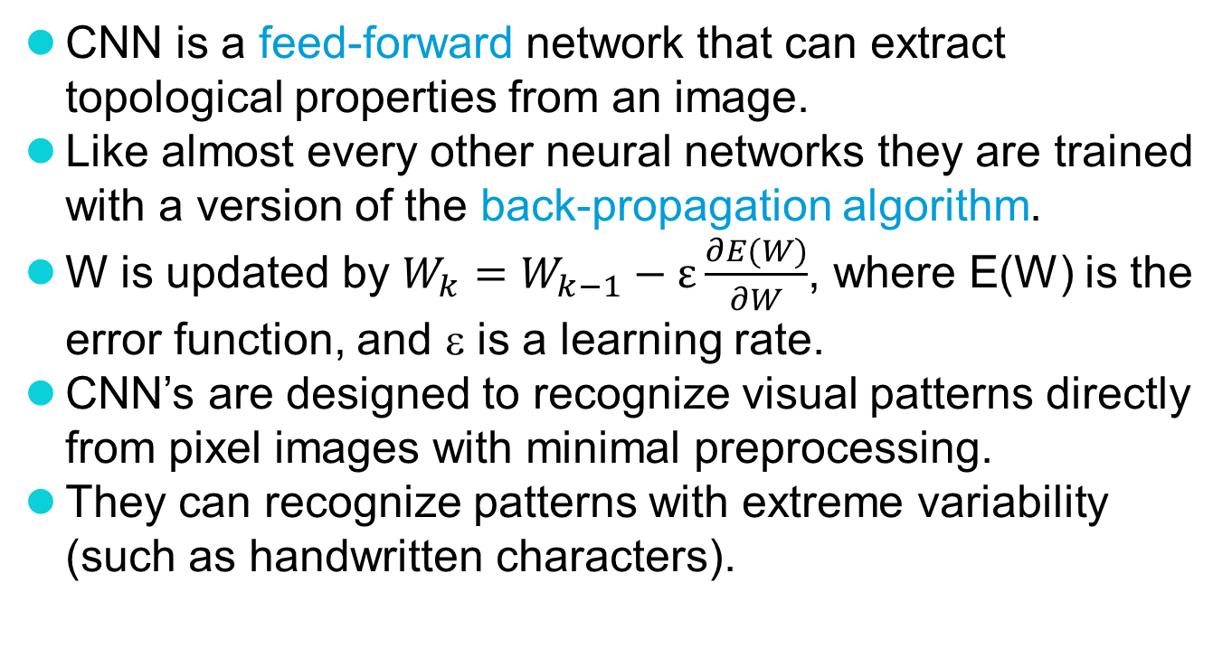
CNN (Cont.)
CNN is a feed-forward network that can extract topological properties from an image.
Like almost every other neural networks they are trained with a version of the back-propagation algorithm.
W is updated by $W_{k}=W_{k−1}−ε\frac{∂E(W)}{∂W}$, where E(W) is the error function, and ε is a learning rate.
CNN’s are designed to recognize visual patterns directly from pixel images with minimal preprocessing.
They can recognize patterns with extreme variability (such as handwritten characters).

Slide 33
CNN (Cont.)
Deep neural networks exploit the property that many natural signals are compositional hierarchies, in which higher-level features are obtained by composing lower-level ones
Properties of CNN
Local connections
Shared weights
Two types of layers
Convoluational layer
Pooling (or subsampling) layer

Slide 34
CNN (Cont.)
Convolutional layer: detect local conjunctions of features from the previous layer
Pooling layer: merge semantically similar features into one
A typical pooling unit computes the maximum of a local patch of units in one feature map
Neighbouring pooling units take input from patches that are shifted by more than one row or column, thereby reducing the dimension of the representation and creating an invariance to small shifts and distortions

Slide 35
An example CNN

Slide 36
Classification
Classification
Convolutional neural network
Pre-processing for feature extraction
f1 … fn
Input
Classification
output
Input
Feature extraction
Shift and distortion invariance
classification
output

Slide 37
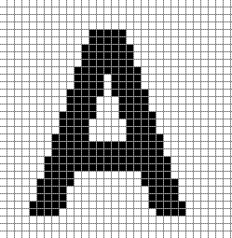
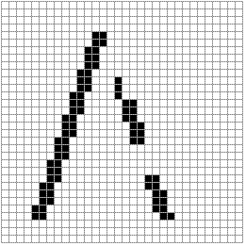
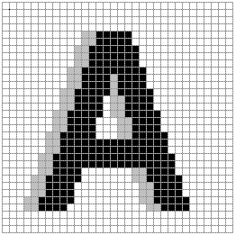
Shift
154 input change from 2 shift left
77 : black to white
77 : white to black
Notes:
32*32

Slide 38
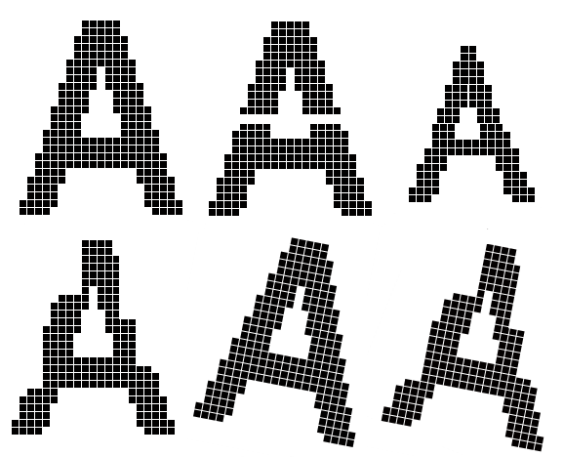
Scaling, and other forms of distortion

Slide 39
Topology of CNN
Feature maps
C
Feature extraction layer
Convolution layer
Shift and distortion invariance or
Pooling layer
P

Slide 40

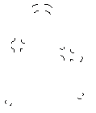
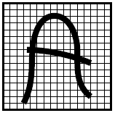
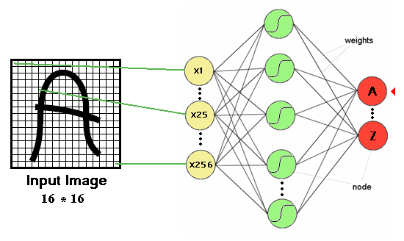
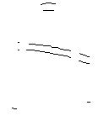
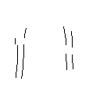

Convolution layer
Detect the same feature at different positions in the input image
features

Slide 41
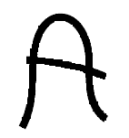
Convolution layer (Cont.)
Convolve with
-1
0
1
Threshold
-1
0
1
-1
0
1
w11
w12
w13
w11
w12
w13
w21
w22
w23
w21
w22
w23
w31
w32
w33
w31
w32
w33

Slide 42


Pooling layer
Weight sharing is also applied in pooling layers
Reduce the effect of noises, shift or distortion
Feature map

Slide 43
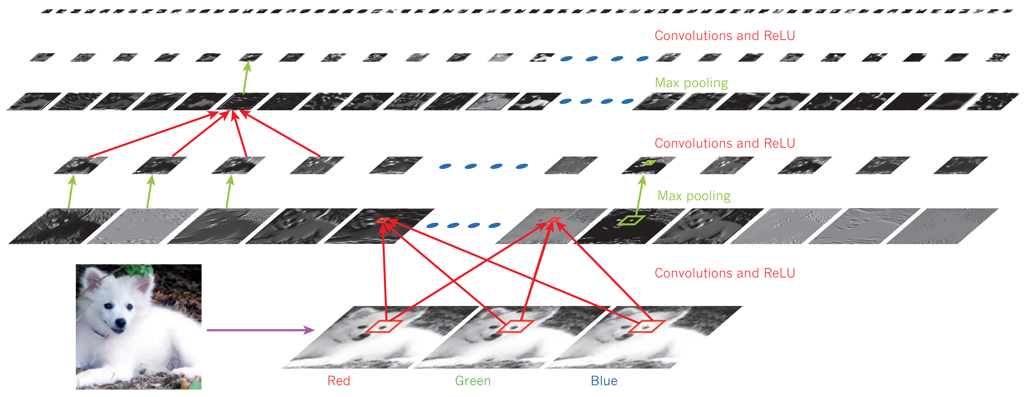
CNN(Cont.)
A convolutional network, where pooling is done by the rectified linear unit (ReLU), a function of f(z) = max(z, 0)

Slide 44
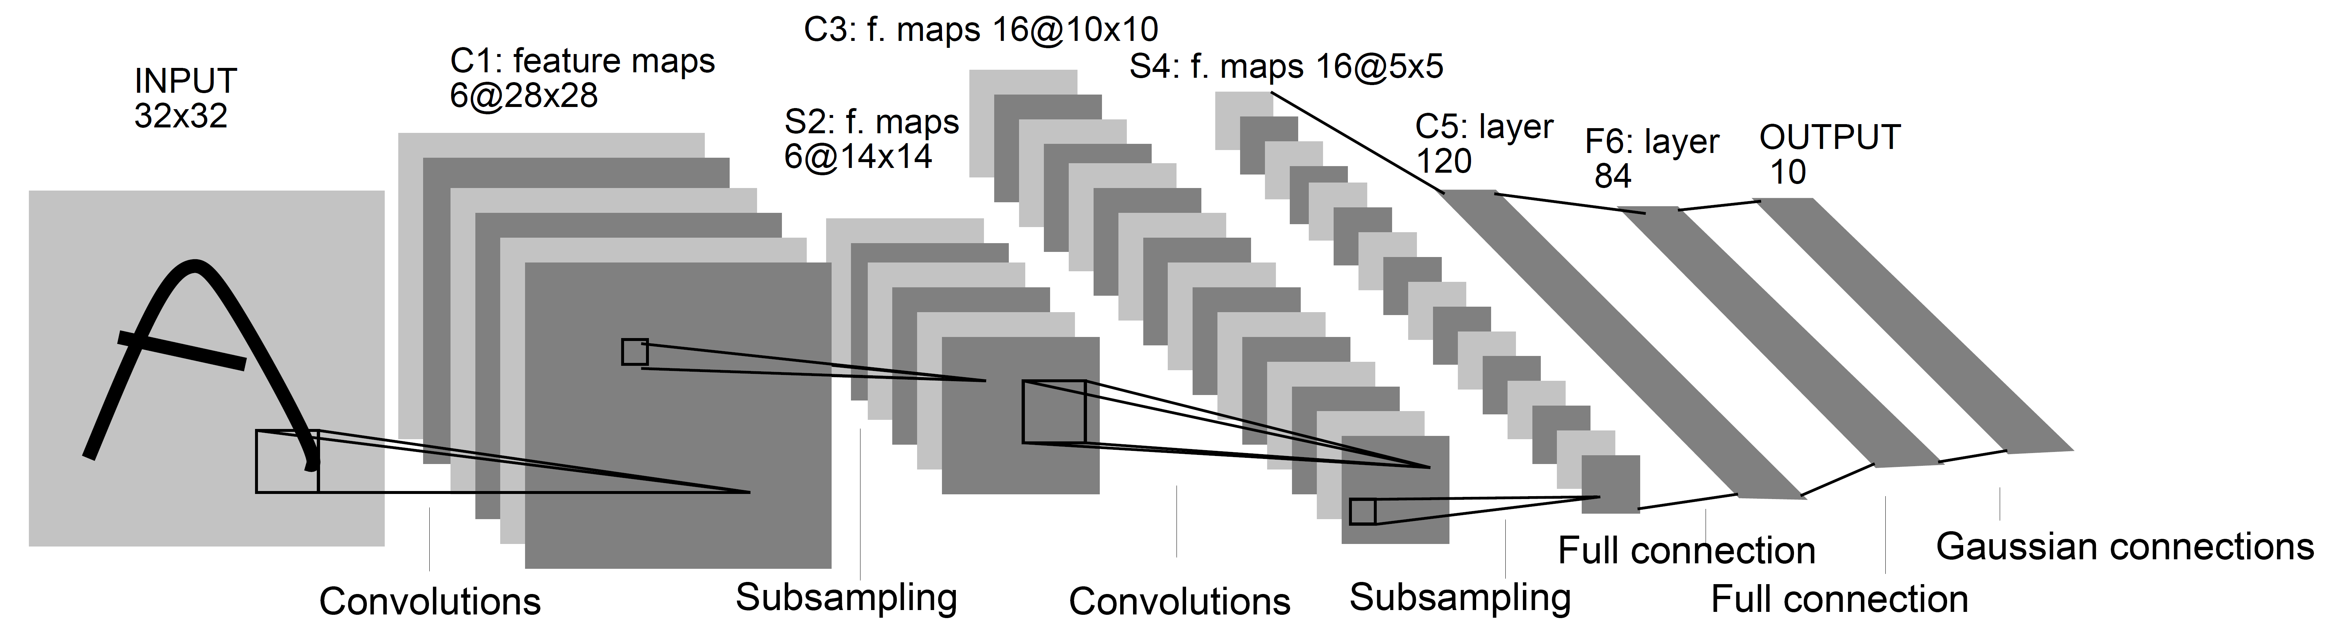
LeNet-5
A convolutional neural network, where C1 and S2 contains 6 feature maps, and C3 and S4 contains 16 feature maps, and so on.
Notes:
Gradient-based learning applied to document recognition, proceedings of IEEE (fot digits’ recognition)
A unit of in a feature map is a 5x5 area
All the units in a feature map share the same set of weights and bias to extract local features. The other feature maps use different sets of weights and biases to extract different types of local features. Thus, the feature maps in C1 extract sis different types of local features.

Slide 45
C3
Each column indicates which feature maps in S2 are combined by the units in a feature map of C3
Notes:
LeNet-5: Gradient-based learning applied to document recognition

Slide 46
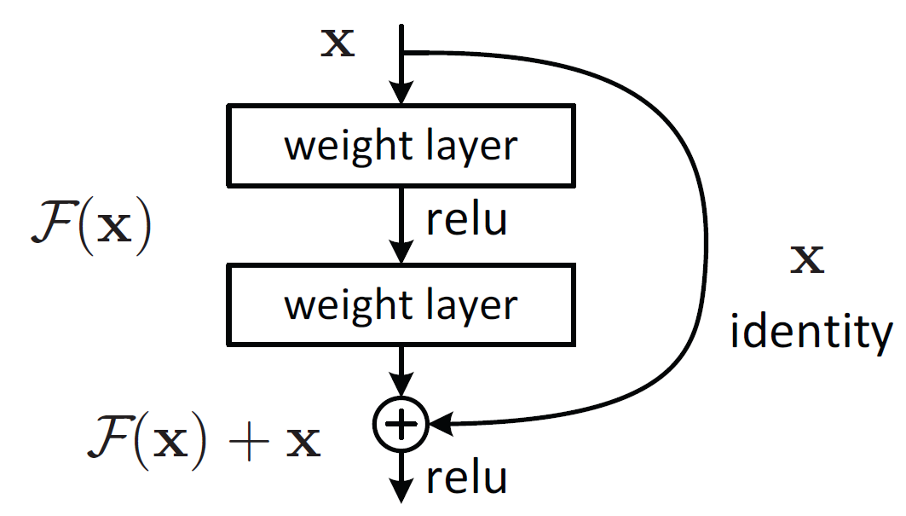
Residual learning
Residual
F(x)=H(x)−x,
where H=F(x)+x
Identity
y=F(x,{W_{i}})+x
Notes:
https://cv-tricks.com/keras/understand-implement-resnets/
https://towardsdatascience.com/understanding-and-visualizing-resnets-442284831be8
https://stackoverflow.com/questions/67954734/different-my-name-of-layer-resnet50-and-original-resnet50

Slide 47
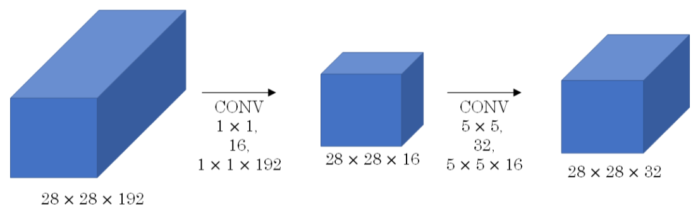
Bottleneck layer
5*5*28*28*192*32=120M operations are required if 32 filters of size 5*5
16*28*28*192+5*5*28*28*32*16=12.4M operations.

Slide 48
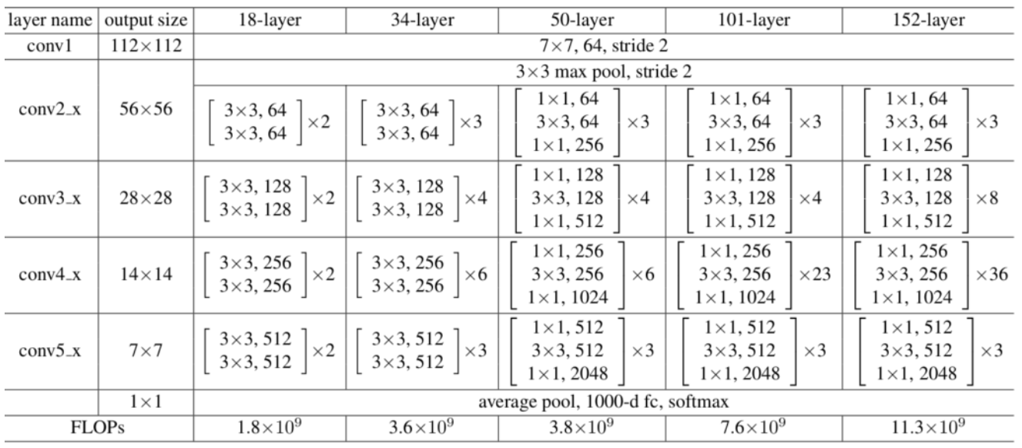
Resnet

Slide 49
Resnet
Variants of ResNet: ResNet-18, ResNet-34, ResNet-50, ResNet-101, ResNet-110, ResNet-152, ResNet-164, ResNet-1202
Input size: 224 x 224 x 3.
Every ResNet architecture performs the initial convolution and max-pooling using 7×7 and 3×3 kernel sizes respectively.
Afterward, it has 3 residual blocks containing 3 layers each.
The convolution operation in the first bottleneck layer of each residual block convi_x is performed with stride 2, hence, the size of input will be reduced to half in terms of height and width but the channel width will be doubled.

Slide 50
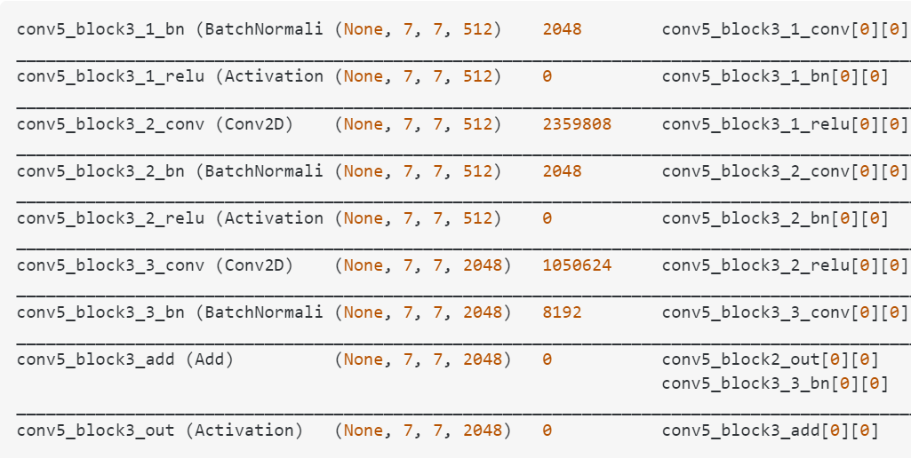
Conv5

Slide 51
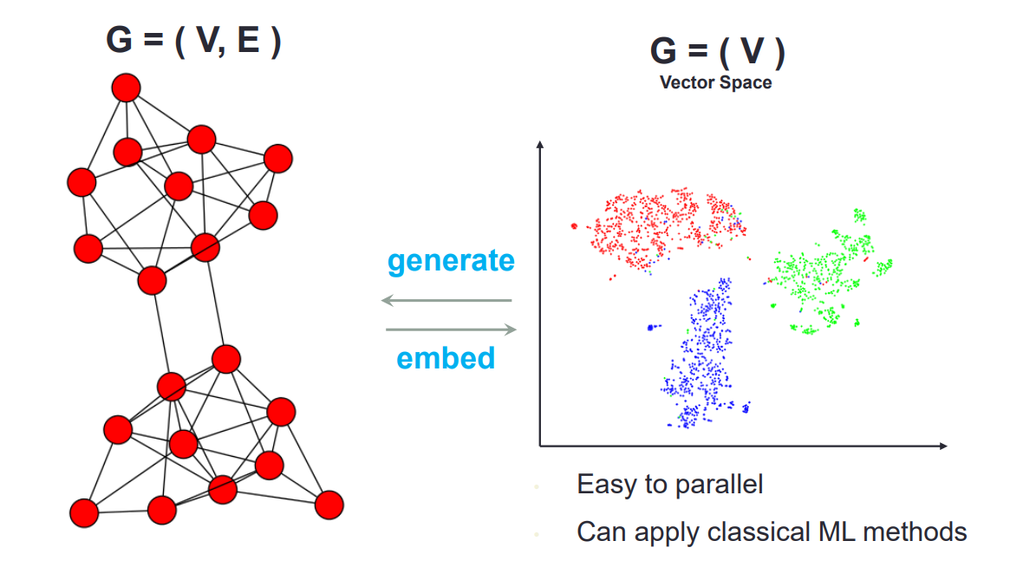
Graph Convolution Networks (GCN)
Network Embedding

Slide 52
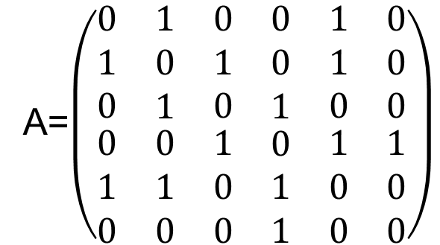
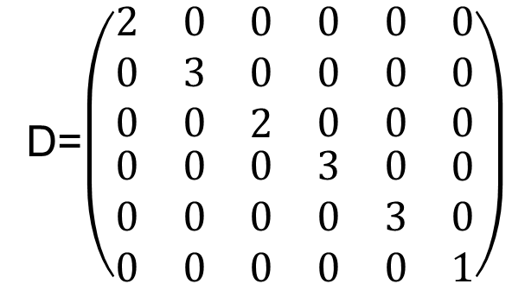
Adjacency and Degree Matrices
D=$\left(\begin{matrix}\begin{matrix}\begin{matrix}2 \\ 0 \\ 0\end{matrix} & \begin{matrix}0 \\ 3 \\ 0\end{matrix}\end{matrix} & \begin{matrix}\begin{matrix}0 \\ 0 \\ 2\end{matrix} & \begin{matrix}0 \\ 0 \\ 0\end{matrix}\end{matrix} & \begin{matrix}\begin{matrix}0 \\ 0 \\ 0\end{matrix} & \begin{matrix}0 \\ 0 \\ 0\end{matrix}\end{matrix} \\ \begin{matrix}\begin{matrix}0 \\ 0 \\ 0\end{matrix} & \begin{matrix}0 \\ 0 \\ 0\end{matrix}\end{matrix} & \begin{matrix}\begin{matrix}0 \\ 0 \\ 0\end{matrix} & \begin{matrix}3 \\ 0 \\ 0\end{matrix}\end{matrix} & \begin{matrix}\begin{matrix}0 \\ 3 \\ 0\end{matrix} & \begin{matrix}0 \\ 0 \\ 1\end{matrix}\end{matrix}\end{matrix}\right)$
6
A=$\left(\begin{matrix}\begin{matrix}\begin{matrix}0 \\ 1 \\ 0\end{matrix} & \begin{matrix}1 \\ 0 \\ 1\end{matrix}\end{matrix} & \begin{matrix}\begin{matrix}0 \\ 1 \\ 0\end{matrix} & \begin{matrix}0 \\ 0 \\ 1\end{matrix}\end{matrix} & \begin{matrix}\begin{matrix}1 \\ 1 \\ 0\end{matrix} & \begin{matrix}0 \\ 0 \\ 0\end{matrix}\end{matrix} \\ \begin{matrix}\begin{matrix}0 \\ 1 \\ 0\end{matrix} & \begin{matrix}0 \\ 1 \\ 0\end{matrix}\end{matrix} & \begin{matrix}\begin{matrix}1 \\ 0 \\ 0\end{matrix} & \begin{matrix}0 \\ 1 \\ 1\end{matrix}\end{matrix} & \begin{matrix}\begin{matrix}1 \\ 0 \\ 0\end{matrix} & \begin{matrix}1 \\ 0 \\ 0\end{matrix}\end{matrix}\end{matrix}\right)$
4
5
1
3
2
Adjacency matrix Degree matrix

Slide 53

GCN (Cont.)
Main idea: pass messages between nodes and aggregate
$$H^{(l+1)}=σ({\tilde{P}H}^{(l)}W^{(l)})$$
where ${\tilde{P}=\tilde{D}}^{−\frac{1}{2}}\tilde{A}{\tilde{D}}^{−\frac{1}{2}}, \tilde{A}=A+I$, A is the adjacency matrix, ${\tilde{D}}_{i,i}=\sum_{j}{{\tilde{A}}_{i,j}}$ is the degree matrix, $W$are learnable parameters.
Stacking multiple layers like CNNs

Slide 54

GCN (Cont.)

Slide 55

GCN (Cont.)

Slide 56
GCN (Cont.)
representation of previous layer

Slide 57
GCN (Cont.)
representation of previous layer
weight matrix

Slide 58

GCN (Cont.)
representation of previous layer
weight matrix
$$h_{u}^{ℓ}$$
0
1
0
$$h_{u}^{ℓ}$$
0
1
0
1
0
0
0
1
1
1
0
0
0
1
1
u
u
0
0
1
0
0
1
1
1
0
1
1
0

Slide 59
GCN (Cont.)
representation of previous layer
weight matrix
$$h_{u}^{ℓ}$$
0
1
0
$$h_{u}^{ℓ}$$
0
1
0
0
1
0
1
0
0
0
1
1
1
0
0
.5
.9
.5
0
1
1
0
1
1
aggregate
u
u
u
0
0
1
0
0
1
1
1
0
0
0
1
1
1
0
1
1
0

Slide 60



GCN (Cont.)
representation of previous layer
weight matrix
$$h_{u}^{ℓ}$$
0
1
0
$$h_{u}^{ℓ}$$
0
1
0
0
1
0
1
0
0
0
1
1
1
0
0
.5
.9
.5
MLP
0
1
1
0
1
1
aggregate
$$σ$$
u
u
u
0
0
1
$$h_{u}^{ℓ+1}$$
0
0
1
1
1
0
0
0
1
1
1
0
1
1
0

Slide 61
RNN, LSTM and GRU

Slide 62
RNN, LSTM and GRU
RNN (Recurrent Neural Network) is a form of neural networks that feed outputs back to the inputs during operation
LSTM (Long Short-Term Memory)
It fixes the vanishing gradient problem of the original RNN
GRU (Gated Recurrent Units)
Like LSTM, it has a forget gate, but has fewer parameters than LSTM, as it lacks an output gate

Slide 63
RNN
Treat each time sample as an unit.
But RNN suffers from the vanishing gradient problem.
h_{t}
A
h₀
h₁
h₂
…
h_{t-1}
A
A
A
A
=
x₁
x₂
x₃
x_{t}
x_{t}

Slide 64



LSTM
Standard RNN
Input concatenate with output then feed to input again
LSTM
The repeating structure is more complicated

Slide 65
Adding C (cell state)
RNN only produces output h at every time update, so the gradient vanishing problem may exist
In LSTM, C and h are produced during each time update
C=cell state (ranges from -1 to 1)
h= hidden state (ranges from -1 to 1)
The system learns C and h together

Slide 66


LSTM
“Bits of memory”
Decide what to forget
Decide what to insert
Long short-term memory
Combine with transformed x_{t}
σ: output in [0,1]
tanh: output in [-1,+1]
Notes:
Info is transferred down the chain, not just propagated
Decide when to insert imformation from input into the “backbone”

Slide 67

Walkthrough
What part of memory to “forget” – zero means forget this bit

Slide 68

Walkthrough
What bits to insert into the next states
What content to store into the next cell state

Slide 69

Walkthrough
Next memory cell content – mixture of not-forgotten part of previous cell and insertion

Slide 70

Walkthrough
What part of cell to output
tanh maps bits to [-1,+1] range

Slide 71
LSTM
(1)
(2)
C_{t-1}
(3)
i_{t}
o_{t}
f_{t}
Notes:
Info is transferred down the chain, not just propagated
Decide when to insert imformation from input into the “backbone”

Slide 72

Implementing an LSTM
For t = 1,…,T:
(1)
(2)
(3)
Notes:
Info is transferred down the chain, not just propagated
Decide when to insert imformation from input into the “backbone”

Slide 73

X is of size nx1
h is of size mx1
C_{t}(mx1)
Forget gate
C_{t-1(mx1)}
i(mx1)
U(mx1)
o_{t}(mx1)
f_{t}(mx1)
h_{t(mx1)}
h_{t-1(mx1)}
Size( X_{t(nx1)} append h_{t-1(mx1)} )=(n+m)x1

Slide 74


GRU
LSTM
Reset gate
Update gate
Combine the forget and input into a single update gate.
Merge the cell state and hidden state.
X,*: element-wise multiply

Slide 75
Generative Adversarial Network (GAN)
GAN was first introduced by Ian Goodfellow et al. in 2014.
Have been used in generating images, videos, poems, some simple conversation.
This co-evolution approach might have far-reaching implications, which may hold the key to making computers a lot more intelligent.

Slide 76



Step-wise generation
Generator
v1
Generator
v2
Generator
v3
Generated
images
Discriminator
v1
Discriminator
v2
Discriminator
v3
Binary classifiers
Real images:

Slide 77
GAN – Learn a discriminator
Randomly sample a vector
Generator
0
0
0
0
Real images
Sampled from DB:
1
1
1
1
image
Discriminator
1/0
(real or fake)

Slide 78


GAN – Learn a generator
Randomly sample a vector
Updating the parameters of generator
Train
this
Generator
v1
v2
The output be classified as “real” (as close to 1 as possible)
They have
Opposite
objectives
Using gradient descent to update the parameters in the generator, but fix the discriminator
Discriminator
v1
Do not
Train
This
1.0
0.13

Slide 79



Use an NN as P_{G}(x; θ)
P_{G}(x,θ)
P_{data}(x)
G
θ
Prior
distribution
of z
Smaller
dimension
Larger
dimension

Slide 80
Basic idea of GAN
Generator G
G is a function, input z, output x
Given a prior distribution P_{prior}(z), a probability distribution P_{G}(x) is defined by function G
Discriminator D
D is a function, input x, output scalar
Evaluate the “difference” between P_{G}(x) and P_{data}(x)
In order for D to find difference between P_{data} from P_{G}, we need a cost function V(G,D): G*=arg min_{G}max_{D}V(G,D)

Slide 81


Basic Idea
G* = arg min_{G}max_{D} V(G,D)
Function: V(G,D) = E_{x~Pdata} [log D(x)] + E_{x~PG}[log(1-D(x))]
Given a generator G, max_{D}V(G,D) evaluates the “difference” between P_{G} and P_{data}
V(G₁,D)
V(G₂,D)
V(G₃,D)
G₁
G₂
G₃
Notes:
D(x) represents the probability that x came from the data rather than pg. We train D to maximize the probability of assigning the correct label to both training examples and samples from G.

Slide 82


Convolution
Notes:
Input:ｎ＊ｎ ->n^2*1
Matrix: (n+2*p-k+1)/s*n^2

Slide 83

Transposed convolution
55
110
52
55
104
52
110
55
104
110
52
104
57
114
50
57
100
50
55
55
52
110
52
104
114
57
100
114
50
100
57
57
50
114
50
100
Notes:
Upper: pad=2
Below: pad=1

Slide 84


Expand each element of the input
Combine together

Slide 85

Transposed convolution

Slide 86

Stride and padding
z=s-1, p’=k-p-1, s’=1, where s, k, p respectively denote the stride, kernel, and padding
o=(i-1)*s+k-2p, where i and o respectively denote the input and output sizes
Notes:
https://datascience.stackexchange.com/questions/6107/what-are-deconvolutional-layers

Slide 87

DCGAN
Notes:
Kernel: 4*4, stride=2*2, 3 channels, padding=1*1
https://pytorch.org/tutorials/beginner/dcgan_faces_tutorial.html
Transpose Convolution (stride=2*2: insert one blank row between rows and insert one blank column between columns in the original feature map)
https://datascience.stackexchange.com/questions/6107/what-are-deconvolutional-layers
nn.ConvTranspose2d( nz, ngf * 8, 4, 1, 0, bias=False),
# filter:4*4, stride:2*2, padding:1*1
nn.ConvTranspose2d(ngf * 8, ngf * 4, 4, 2, 1, bias=False),
nn.ConvTranspose2d( ngf * 4, ngf * 2, 4, 2, 1, bias=False),
nn.ConvTranspose2d( ngf * 2, ngf, 4, 2, 1, bias=False),
nn.ConvTranspose2d( ngf, nc, 4, 2, 1, bias=False),
nn.Tanh()
Architecture guidelines for stable Deep Convolutional GANs
Replace any pooling layers with strided convolutions (discriminator) and fractional-strided
convolutions (generator).
Use batchnorm in both the generator and the discriminator.
Remove fully connected hidden layers for deeper architectures.
Use ReLU activation in generator for all layers except for the output, which uses Tanh.
Use LeakyReLU activation in the discriminator for all layers.

Slide 88
Neural Network as a Classifier
Weakness
Long training time
Require a number of parameters typically best determined empirically, e.g., the network topology or “structure."
Poor interpretability: Difficult to interpret the symbolic meaning behind the learned weights and of “hidden units" in the network
Strength
High tolerance to noisy data
Ability to classify untrained patterns
Well-suited for continuous-valued inputs and outputs
Successful on a wide array of real-world data
Algorithms are inherently parallel
Techniques have recently been developed for the extraction of rules from trained neural networks

Slide 89

Attention in a seq2seq
Given a sequence x =($x_{1},x_{2},…,x_{n}$), translation is to find a target sentence y that maximizes the conditional probability of y given a source sentence x, i.e. $\arg{\max_{y} p(y|x)}$.
Encoder (RNN), $h_{j}=f(x_{j},h_{j−1})$
Decoder (RNN), ${p(y}_{i}|y_{1},y_{2},…,y_{i−1},x)=g(y_{i−1},s_{i},c_{i})$, $s_{i}=g(y_{i−1},s_{i−1},c_{i})$,
$c_{i}=\sum_{j=1}^{n}{{α′}_{i,j}h_{j}}$
${α′}_{i,j}=\frac{{exp⁡(α}_{i,j})}{\sum_{k=1}^{n}{{exp⁡(α}_{i,k})}}$
$α_{i,j}=V^{T}tanh⁡(Ws_{i}+Uh_{j})$
Notes:
Seq2Seq neural machine translation by jointly learning to align and translate.pdf

Slide 90









$$α_{i,j}$$
additive
$$V^{T}$$
$$tanh$$
$$α_{i,j}=V^{T}tanh⁡(Ws_{i}+Uh_{j})$$
$$+$$
$$W$$
$$U$$
$$s_{i−1}$$
$$h_{j}$$

Slide 91















$$c_{i}=\sum_{j=1}^{n}{{α′}_{i,j}h_{j}}$$
…
attention score
$$α_{i,1}^{′}$$
$$α_{i,2}^{′}$$
$$α_{i,3}^{′}$$
$$α_{i,n}^{′}$$
$${α′}_{i,j}=\frac{{exp⁡(α}_{i,j})}{\sum_{k=1}^{n}{{exp⁡(α}_{i,k})}}$$
Soft-max
…
$$α_{i,1}$$
$$α_{i,2}$$
$$α_{i,3}$$
$$α_{i,n}$$
$$α_{i,j}=V^{T}tanh⁡(Ws_{i}+Uh_{j})$$
…
Input
$$h_{1}$$
$$h_{2}$$
$$h_{3}$$
$$h_{n}$$

Slide 92


Transformer
The transformer has an encoder-decoder structure.
The encoder maps an input sequence of symbol representations ($x_{1},x_{2},…,x_{n}$) to a sequence of continuous representations z = ($z_{1},z_{2},…,z_{n}$).
Given z, the decoder generates an output sequence ($y_{1},y_{2},…,y_{m}$) of symbols one element at a time.
encoder
decoder
Notes:
Attention is all you needed.pdf
N=6
Decoder: We also modify the self-attention sub-layer in the decoder stack to prevent positions from attending to subsequent positions. This
masking, combined with fact that the output embeddings are offset by one position, ensures that the predictions for position i can depend only on the known outputs at positions less than i.

Slide 93

Self-attention
Given a sequence I =($a_{1},a_{2},…,a_{n}$), the self-attention module generates the output O =($b_{1},b_{2},…,b_{n}$), where queries $Q=(q^{1},q^{2},…,q^{n})$, keys $K=(k^{1},k^{2},…,k^{n})$, $V=(v^{1},v^{2},…,v^{n})$, $q^{i}={(W}^{q}a^{i}),k^{i}={(W}^{k}a^{i}),$ $v^{i}={(W}^{v}a^{i}),d_{k}\text{: }\text{dimension} \text{of} \text{queries} \text{and} \text{keys}$.
$Attention\left(Q,K,V\right)=Softmax\left(\frac{QK^{T}}{\sqrt{d_{k}}}\right)V$
$b^{i}=\sum_{j=1}^{n}{{α′}_{i,j}v^{j}=\sum_{j=1}^{n}{{α′}_{i,j}{(W}^{v}a^{j}}})$
${α′}_{i,j}=\frac{{exp⁡(α}_{i,j})}{\sum_{k=1}^{n}{{exp⁡(α}_{i,k})}}$
$α_{i,j}=q^{i}{∙k}^{j}={(W}^{q}a^{i})∙(W^{k}a^{j})$
Notes:
computation that can be parallelized
Learning long-range dependencies

Slide 94








Dot-product
$$α_{i,j}$$
$$α_{i,j}=q^{i}{∙k}^{j}$$
$$q^{i}$$
$$k^{j}$$
$$W^{q}$$
$$W^{k}$$
$$a^{i}$$
$$a^{j}$$

Slide 95






















Self-attention
$$α_{1,1}=q^{1}∙k^{1}$$
$$α_{1,2}=q^{1}∙k^{2}$$
$$α_{1,3}=q^{1}∙k^{3}$$
. . .
$$α_{1,n}=q^{1}∙k^{n}$$
$$α_{1,1}$$
$$α_{1,2}$$
$$α_{1,3}$$
. . .
$$α_{1,n}$$
attention score
query
$$q^{1}$$
$$k^{1}$$
$$k^{2}$$
key
$$k^{3}$$
. . .
$$k^{n}$$
Input
$$a^{1}$$
$$a^{2}$$
$$a^{3}$$
. . .
$$a^{n}$$
$$q^{1}=W^{q}a^{1}$$
$$k^{2}=W^{k}a^{2}$$
$$k^{3}=W^{k}a^{3}$$
. . .
$$k^{n}=W^{k}a^{n}$$
$$k^{1}=W^{k}a^{1}$$

Slide 96






Self-attention
$$α_{1,i}^{′}=exp\left(α_{1,i} \right)/\sum_{j}{exp\left(α_{1,j} \right)}$$
$$α_{1,1}^{′}$$
$$α_{1,2}^{′}$$
$$α_{1,3}^{′}$$
. . .
$$α_{1,n}^{′}$$
Soft-max
$$α_{1,1}$$
$$α_{1,2}$$
$$α_{1,3}$$
. . .
$$α_{1,n}$$
$$q^{1}$$
$$k^{1}$$
$$k^{2}$$
$$k^{3}$$
. . .
$$k^{n}$$
$$a^{1}$$
$$a^{2}$$
$$a^{3}$$
. . .
$$a^{n}$$
$$q^{1}=W^{q}a^{1}$$
$$k^{2}=W^{k}a^{2}$$
$$k^{3}=W^{k}a^{3}$$
. . .
$$k^{n}=W^{k}a^{n}$$
$$k^{1}=W^{k}a^{1}$$

Slide 97


















Self-attention
$$b^{1}=\sum_{i}{α_{1,i}^{′}v^{i} }$$
Extract information based on attention scores
$$b^{1}$$
$$α_{1,1}^{′}$$
$$α_{1,2}^{′}$$
$$α_{1,3}^{′}$$
. . .
$$α_{1,n}^{′}$$
$$q^{1}$$
$$k^{1}$$
$$v^{1}$$
$$k^{2}$$
$$v^{2}$$
$$k^{3}$$
$$v^{3}$$
$$k^{n}$$
$$v^{n}$$
$$a^{1}$$
$$a^{2}$$
$$a^{3}$$
. . .
$$a^{n}$$
$$v^{1}=W^{v}a^{1}$$
$$v^{2}=W^{v}a^{2}$$
$$v^{3}=W^{v}a^{3}$$
. . .
$$v^{n}=W^{v}a^{n}$$

Slide 98















Self-attention
$$b^{2}=\sum_{i}{α_{2,i}^{′}v^{i} }$$
$$b^{3}=\sum_{i}{α_{3,i}^{′}v^{i} }$$
$$b^{n}=\sum_{i}{α_{n,i}^{′}v^{i} }$$
$$b^{2}$$
$$α_{2,1}^{′}$$
$$α_{2,2}^{′}$$
$$α_{2,3}^{′}$$
. . .
$$α_{2,n}^{′}$$
$$q^{1}$$
$$k^{1}$$
$$v^{1}$$
$$q^{2}$$
$$k^{2}$$
$$v^{2}$$
$$q^{3}$$
$$k^{3}$$
$$v^{3}$$
$$q^{n}$$
$$k^{n}$$
$$v^{n}$$
$$a^{1}$$
$$a^{2}$$
$$a^{3}$$
. . .
$$a^{n}$$

Slide 99






































Self-attention
$$q^{1}$$
$$q^{2}$$
$$q^{3}$$
. . .
$$q^{n}$$
$$a^{1}$$
$$a^{2}$$
$$q^{i}=W^{q}a^{i}$$
=
$$a^{3}$$
$$a^{n}$$
$$W^{q}$$
. . .
$$Q$$
$$I$$
$$a^{1}$$
$$a^{2}$$
$$k^{1}$$
$$k^{n}$$
$$a^{3}$$
$$k^{2}$$
. . .
$$a^{n}$$
$$k^{i}=W^{k}a^{i}$$
$$k^{3}$$
=
$$W^{k}$$
. . .
$$K$$
$$I$$
$$a^{1}$$
$$a^{2}$$
$$v^{1}$$
$$a^{3}$$
$$a^{n}$$
$$v^{2}$$
$$v^{3}$$
$$v^{n}$$
=
. . .
$$v^{i}=W^{v}a^{i}$$
. . .
$$W^{v}$$
$$V$$
$$I$$
$$q^{1}$$
$$k^{1}$$
$$v^{1}$$
$$q^{2}$$
$$k^{2}$$
$$v^{2}$$
$$q^{3}$$
$$k^{3}$$
$$v^{3}$$
$$q^{n}$$
$$k^{n}$$
$$v^{n}$$
$$a^{1}$$
$$a^{2}$$
$$a^{3}$$
. . .
$$a^{n}$$

Slide 100






















Self-attention
$$α_{1,1}$$
$$k^{1}$$
$$α_{1,2}$$
$$k^{2}$$
$$α_{1,1}=$$
$$k^{1}$$
$$q^{1}$$
$$α_{1,2}=$$
$$k^{2}$$
$$q^{1}$$
$$q^{1}$$
$$α_{1,3}$$
$$=$$
$$k^{3}$$
$$α_{1,3}=$$
$$k^{3}$$
$$q^{1}$$
$$α_{1,n}=$$
$$k^{n}$$
$$q^{1}$$
. . .
. . .
$$α_{1,n}$$
$$k^{n}$$
$$α_{1,1}$$
$$α_{1,2}$$
$$α_{1,3}$$
. . .
$$α_{1,n}$$
$$q^{1}$$
$$k^{1}$$
$$v^{1}$$
$$q^{2}$$
$$k^{2}$$
$$v^{2}$$
$$q^{3}$$
$$k^{3}$$
$$v^{3}$$
. . .
$$q^{n}$$
$$k^{n}$$
$$v^{n}$$

Slide 101

















































Self-attention
$$α_{2,1}$$
$$α_{2,2}$$
$$α_{2,3}$$
. . .
$$α_{2,n}$$
$$q^{1}$$
$$k^{1}$$
$$v^{1}$$
$$q^{2}$$
$$k^{2}$$
$$v^{2}$$
$$q^{3}$$
$$k^{3}$$
$$v^{3}$$
. . .
$$q^{n}$$
$$k^{n}$$
$$v^{n}$$
$$α_{1,1}^{′}$$
$$α_{2,1}^{′}$$
$$α_{3,1}^{′}$$
. . .
$$α_{n,1}^{′}$$
$$α_{1,1}$$
$$α_{2,1}$$
$$α_{3,1}$$
. . .
$$α_{n,1}$$
$$k^{1}$$
$$α_{1,2}^{′}$$
$$α_{2,2}^{′}$$
$$α_{3,2}^{′}$$
. . .
$$α_{n,2}^{′}$$
$$α_{1,2}$$
$$α_{2,2}$$
$$α_{3,2}$$
. . .
$$α_{n,2}$$
$$k^{2}$$
$$α_{1,3}^{′}$$
$$α_{2,3}^{′}$$
$$α_{3,3}^{′}$$
. . .
$$α_{n,3}^{′}$$
$$α_{1,3}$$
$$α_{2,3}$$
$$α_{3,3}$$
. . .
$$α_{n,3}$$
$$k^{3}$$
$$q^{1}$$
$$q^{2}$$
. . .
$$=$$
$$q^{3}$$
$$q^{n}$$
. . .
. . .
. . .
. . .
. . .
. . .
. . .
. . .
. . .
$$α_{1,4}^{′}$$
$$α_{2,4}^{′}$$
$$α_{3,4}^{′}$$
. . .
$$α_{n,4}^{′}$$
$$α_{1,4}$$
$$α_{2,4}$$
$$α_{3,4}$$
. . .
$$α_{n,4}$$
$$k^{n}$$
$$Q$$
$$A′$$
softmax
$$A$$
$$K^{T}$$

Slide 102







































Self-attention
$$b^{1}$$
$$α_{1,1}^{′}$$
$$α_{1,2}^{′}$$
$$α_{1,3}^{′}$$
. . .
$$α_{1,n}^{′}$$
$$q^{1}$$
$$k^{1}$$
$$v^{1}$$
$$q^{2}$$
$$k^{2}$$
$$v^{2}$$
$$q^{3}$$
$$k^{3}$$
$$v^{3}$$
. . .
$$q^{n}$$
$$k^{n}$$
$$v^{n}$$
$$α_{1,1}^{′}$$
$$α_{2,1}^{′}$$
$$α_{3,1}^{′}$$
. . .
$$α_{n,1}^{′}$$
$$α_{1,2}^{′}$$
$$α_{2,2}^{′}$$
$$α_{3,2}^{′}$$
. . .
$$α_{n,2}^{′}$$
$$b^{1}$$
$$b^{3}$$
$$b^{2}$$
$$b^{n}$$
=
. . .
$$v^{1}$$
$$v^{2}$$
$$v^{n}$$
$$v^{3}$$
. . .
$$α_{1,3}^{′}$$
$$α_{2,3}^{′}$$
$$α_{3,3}^{′}$$
. . .
$$α_{n,3}^{′}$$
$$O$$
$$V$$
. . .
. . .
. . .
. . .
$$α_{1,4}^{′}$$
$$α_{2,4}^{′}$$
$$α_{3,4}^{′}$$
. . .
$$α_{n,4}^{′}$$
$$A′$$

Slide 103

Multi-head self-attention
MultiHead(Q,K,V)=Concat(head₁, head₂, …, head_{h})W^{O}, where ${head}_{l}=Attention(QW_{l}^{Q},$ K$W_{l}^{K},$ V$W_{l}^{V})$, l=1, 2, …, h.

Slide 104
























Multi-head Self-attention
Different aspects of relevance
$$q^{i,1}=W^{q,1}q^{i}$$
$$b^{i,1}$$
$$q^{i,2}=W^{q,2}q^{i}$$
$$q^{i,1}$$
$$q^{i,2}$$
$$k^{i,1}$$
$$k^{i,2}$$
$$v^{i,1}$$
$$v^{i,2}$$
$$q^{j,1}$$
$$q^{j,2}$$
$$k^{j,1}$$
$$k^{j,2}$$
$$v^{j,1}$$
$$v^{j,2}$$
$$q^{i}$$
$$k^{i}$$
$$v^{i}$$
$$q^{j}$$
$$k^{j}$$
$$v^{j}$$
$$q^{i}=W^{q}a^{i}$$
$$a^{i}$$
(2 heads as example)
$$a^{j}$$

Slide 105



Multi-head Self-attention
Different aspects of relevance
$$b^{i,1}$$
$$b^{i}$$
=
$$W^{O}$$
$$b^{i,2}$$
$$q^{i,1}$$
$$q^{i,2}$$
$$k^{i,1}$$
$$k^{i,2}$$
$$v^{i,1}$$
$$v^{i,2}$$
$$q^{j,1}$$
$$q^{j,2}$$
$$k^{j,1}$$
$$k^{j,2}$$
$$v^{j,1}$$
$$v^{j,2}$$
$$q^{i}$$
$$k^{i}$$
$$v^{i}$$
$$q^{j}$$
$$k^{j}$$
$$v^{j}$$
$$q^{i}=W^{q}a^{i}$$
$$a^{i}$$
(2 heads as example)
$$a^{j}$$

Slide 106



How to make self-attention efficient
key
$$n$$
$$n$$
Attention Matrix
query
$$n×n$$
(n:sequence length)

Slide 107
Skip Some Calculations with Human Knowledge
Can we fill in some values with human knowledge?

Slide 108
Local Attention / Truncated Attention
Set to 0
……
query
Similar with CNN
Calculate attention weight
key

Slide 109
Stride Attention
…
…

Slide 110
Global Attention
special token = liaison
Add special token into original sequence
Attend to every token $→$ collect global information
Attended by every token $→$ it knows global information
No attention between non-special token
Notes:
First two: special token, first two rows: each special token (query) attends to every token (key), first two columns: each special token (key) is attended by every token (query)
Row: query, column:key

Slide 111
Many Different Choices
Different heads use different patterns

Slide 112


Many Different Choices (Cont.)
Longformer
Big Bird

Slide 113
Can we only focus on Critical Parts?
key
small value
Directly set to 0
query
Smaller influence on results
large value
How to quickly estimate the portion with small attention weights?

Slide 114
Clustering
(Reformer & Routing Transformer)
Step 1
query
key
Clustering
based on similarity
(approximate & fast)
1
4
1
2
3
3
3
2
2
1
3
3
1
4
1
4

Slide 115
key
Clustering
Step 2
In the same cluster, calculate attention weight
query
Not the same cluster, set to 0

Slide 116
Do we need full attention matrix?
Many redundant columns
query
key
Low Rank

Slide 117




$$N$$
$$N$$
value
key
$$K$$
$$K$$
Can we reduce the number of queries?
query
change output sequence length

Slide 118


Parallel co-attention
Parallel co-attention model jointly reasons about image and question attention for visual question answering.
Image feature map $V∈R^{d×n}$contains the regional features ($v_{1},v_{2},…,v_{n}$) in the image, q$uestion represention Q∈R^{d×t}$contains gram features ($q_{1},q_{2},…,q_{t}$).
Notes:
Hierarchical Question-Image Co-Attention for Visual Question Answering

Slide 119

Parallel co-attention (Cont.)
The new representations of image and question are derived as follows, where $C$ is the affinity matrix, $a^{v}$ and $a^{q}$ are the attention probabilities of each image region $v_{i}$and $q_{j}$, respectively.
$C=tanh⁡(Q^{T}W_{c}V)$
$H^{v}=W_{hv}^{T}tanh⁡(W_{v}V+W_{q}\left(QC\right))$ $H^{q}=W_{hq}^{T}tanh\left(W_{q}Q+W_{v}\left(VC^{T}\right)\right)$
$a^{v}=softmax⁡(H^{v})$ $a^{q}=softmax\left(H^{q}\right)$
$\hat{v}=\sum_{i=1}^{n}{a_{i}^{v}v_{i}}$, $\hat{q}=\sum_{j=1}^{t}{a_{j}^{q}q_{j}}$
The affinity matrix $C$ transforms question attention space to image attention space (vice versa for $C^{T}$).
Notes:
$$V∈R^{d×n}, Q∈R^{\begin{aligned}d×t \\ \end{aligned}}C∈R^{t×n}$$
$W_{c}∈R^{d×d}, W_{v}$, $W_{q}∈R^{k×d}$, $W_{hv}$, $W_{hq}∈R^{k}$, $a^{v}∈R^{n}$, $a^{q}∈R^{t}$
Prediction is made by softmax(tanh($W_{p}$concat($\hat{v}$, $\hat{q}$))

